Slide 1
One-shot NAS Papers

Slide 2
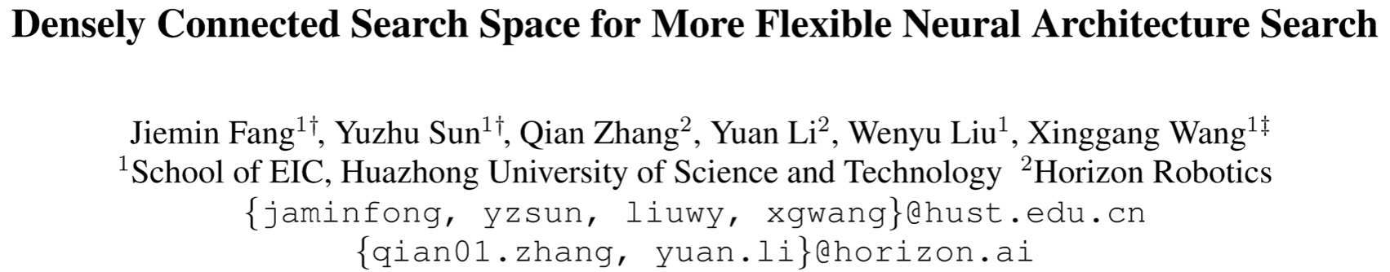

Slide 3
Search Space
Block: A set of layers/operations which output feature map with the same spatial resolution and the same number of channels.
Stage: A set of sequential blocks.
The number and widths of blocks are set manually. It means that the depth search is constrained within the block and the width search cannot be performed.

Slide 4
Search Space Design
Basic Layers: Candidate operations (MBConv and skip connection)
Shape-alignment Layers: In the form of several parallel branches, while every branch is a set of candidate operations.
Routing Block: Shape-alignment layers and basic layers.

Slide 5
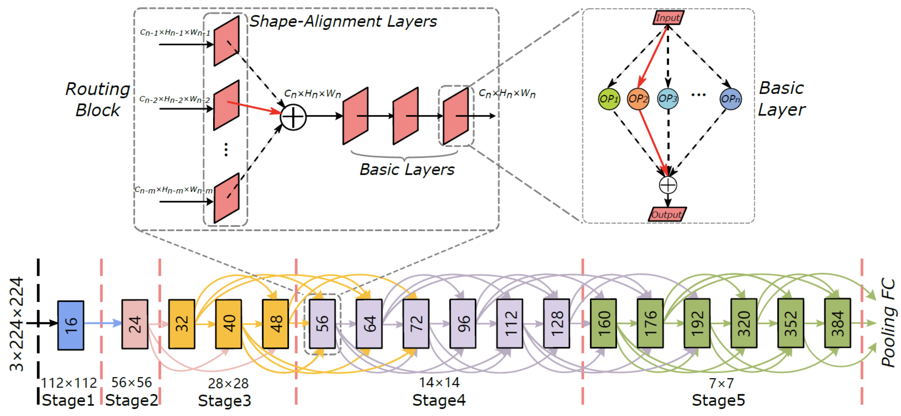
Search Space Design

Slide 6
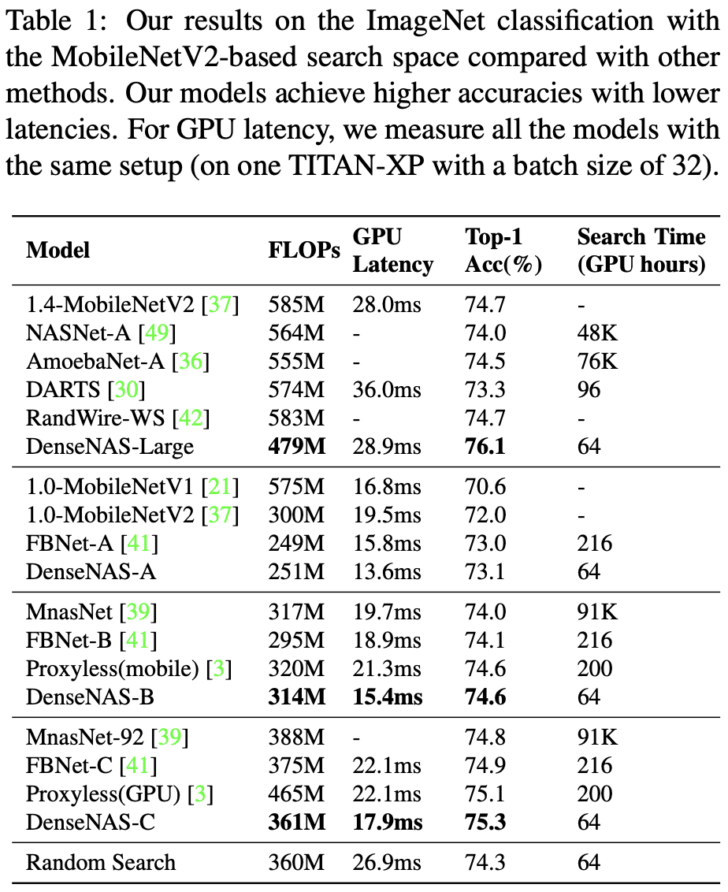
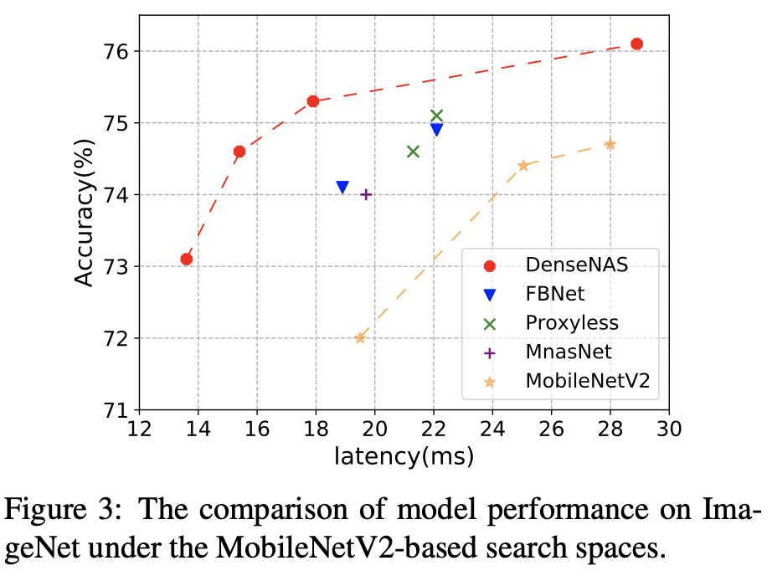
Experiment-MobileNetV2

Slide 7
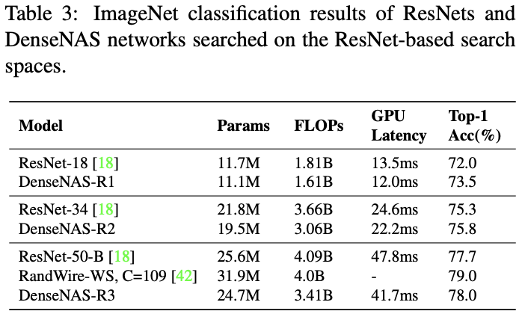
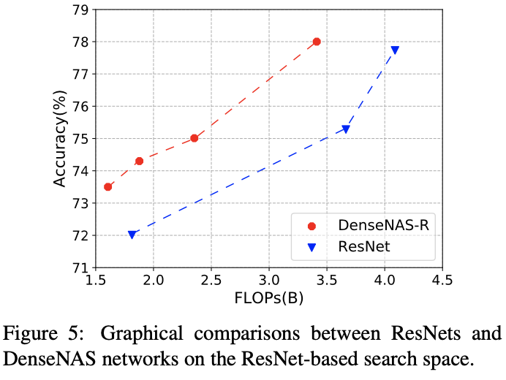
Experiment-ResNet

Slide 8
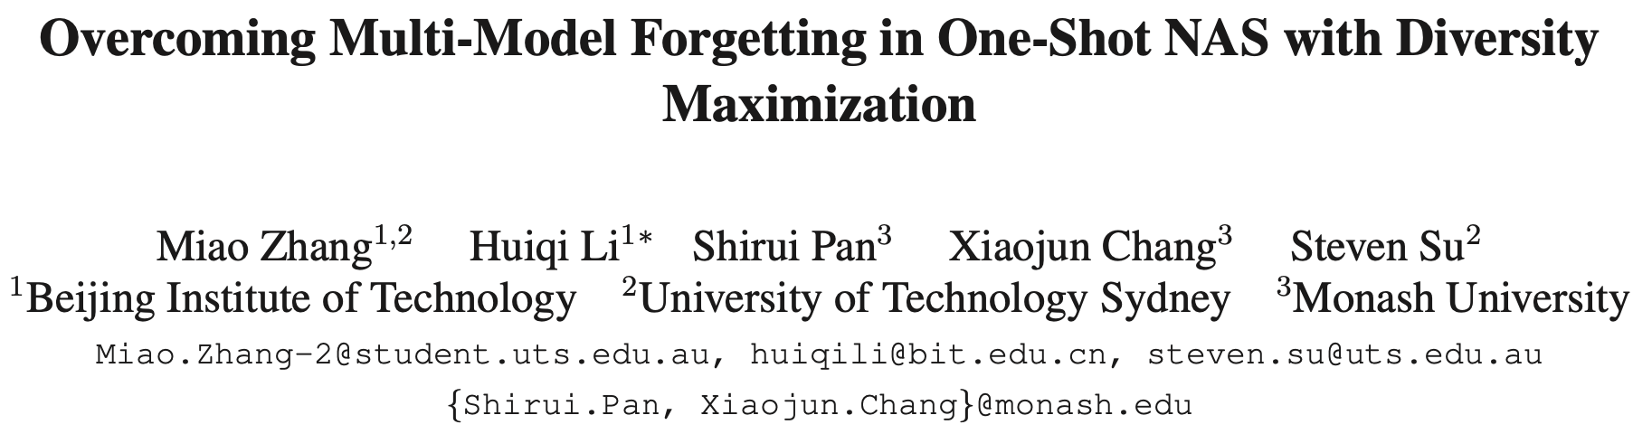

Slide 9
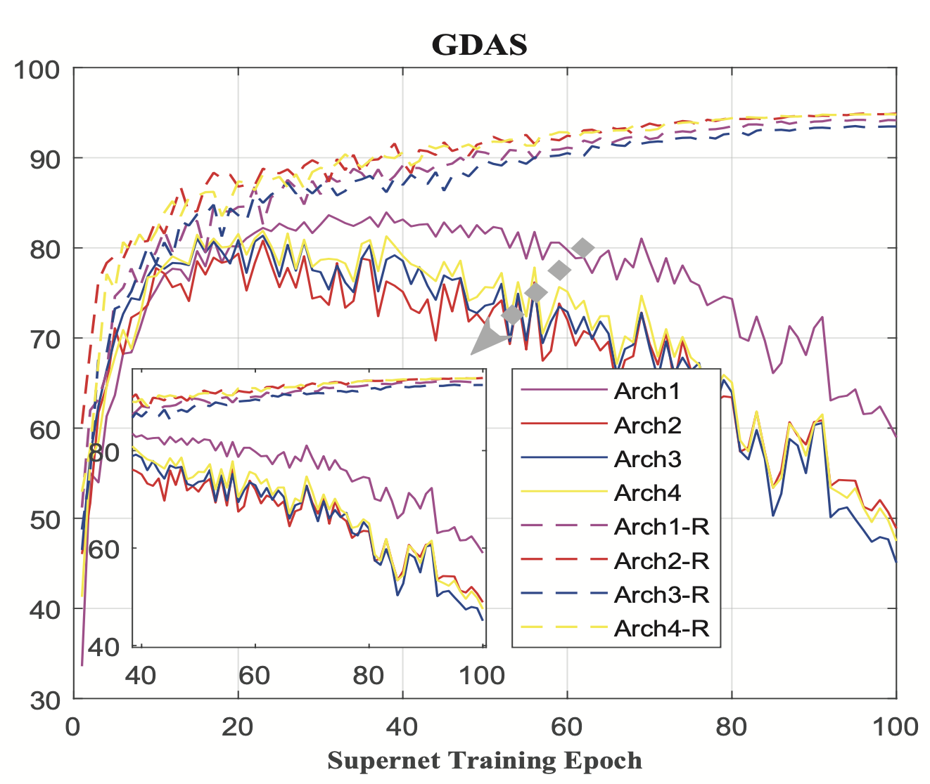
Issue of One-shot NAS
The validation accuracy of architecture with inherited weights should approximate to the test accuracy after retraining or be highly predictive.

Slide 10
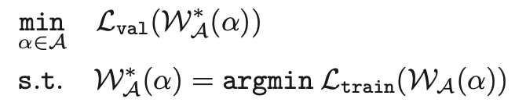
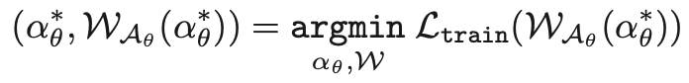
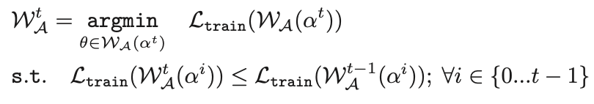
Problem Formulation
1.
2.
In practice, we try to select a subset with M constraints from previous architectures that the feasible region formed by the subset is as close to the original feasible region as possible.
The constraints prevent the learning of current architecture degrading the performance of previous architectures to overcome the multi-model forgetting in One-Shot NAS.

Slide 11
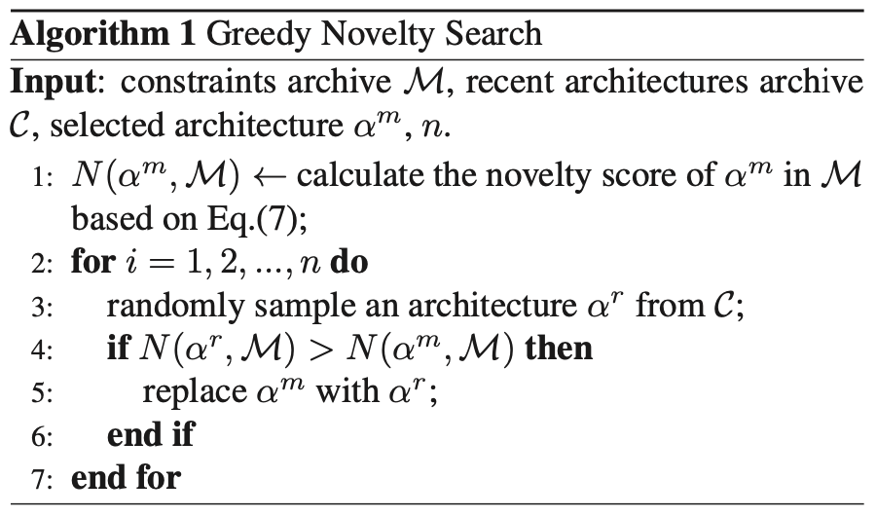
Search Architectures

Slide 12
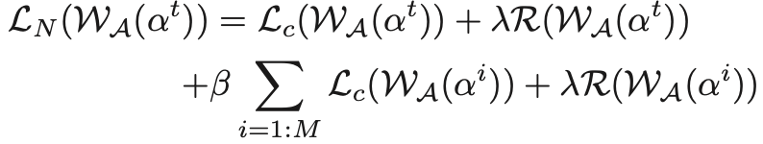
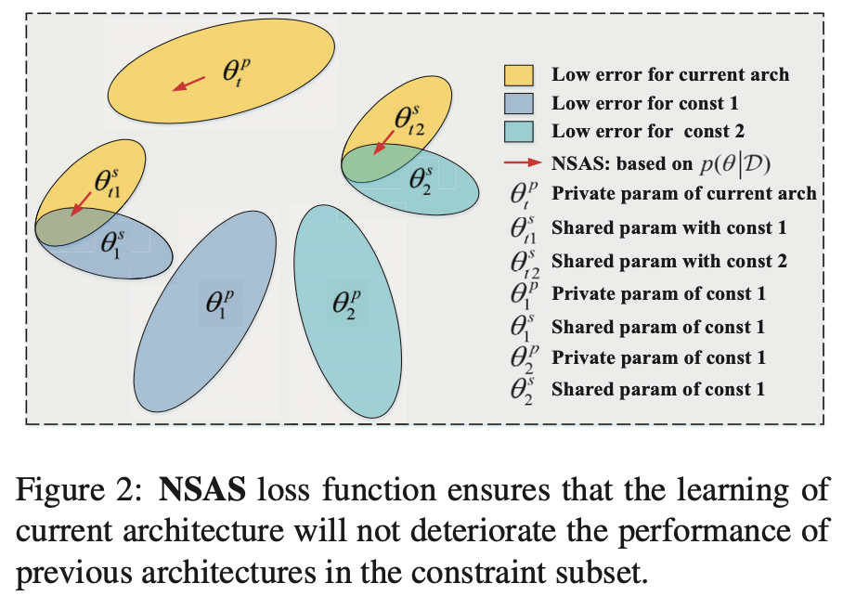
Loss Function

Slide 13
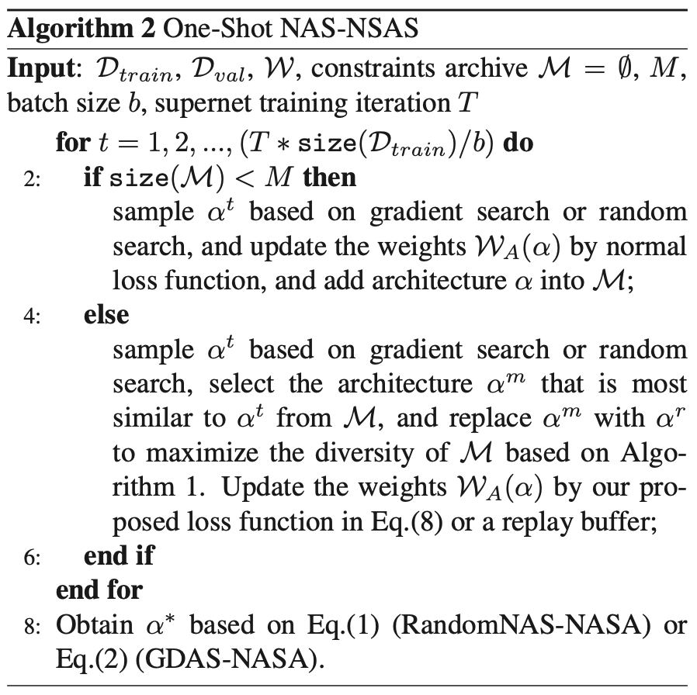
Algorithm

Slide 14
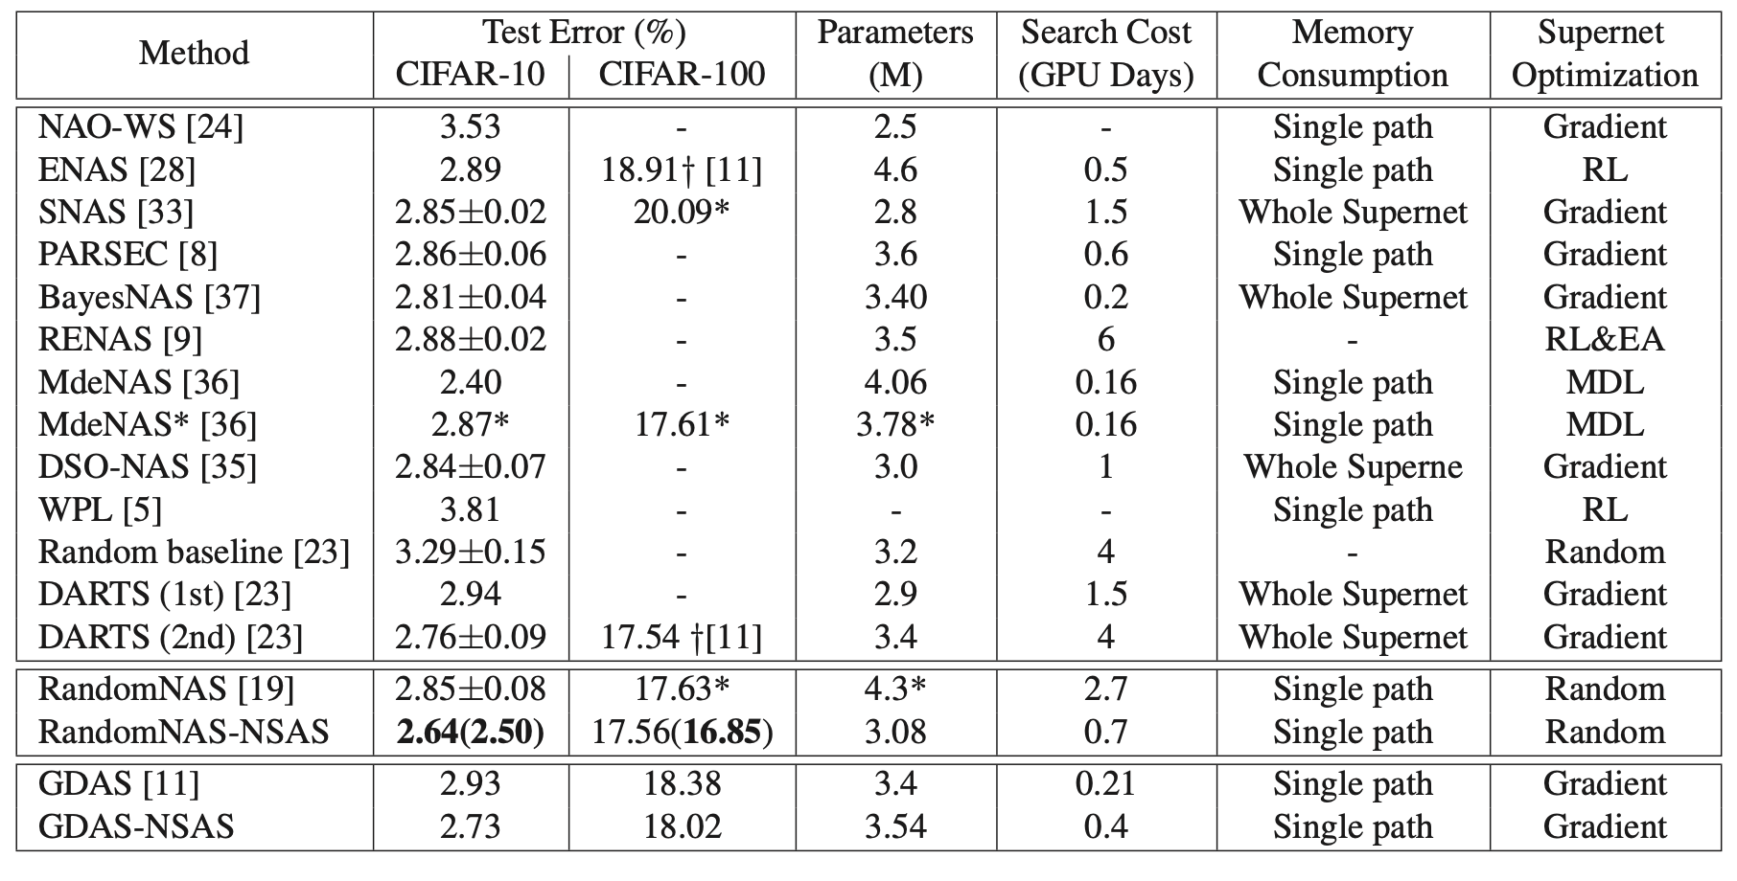
Experiment

Slide 15
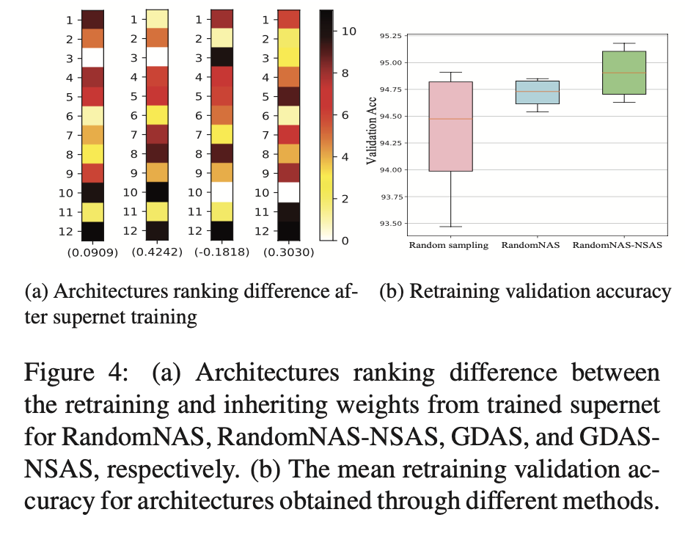
Correlation

Slide 16
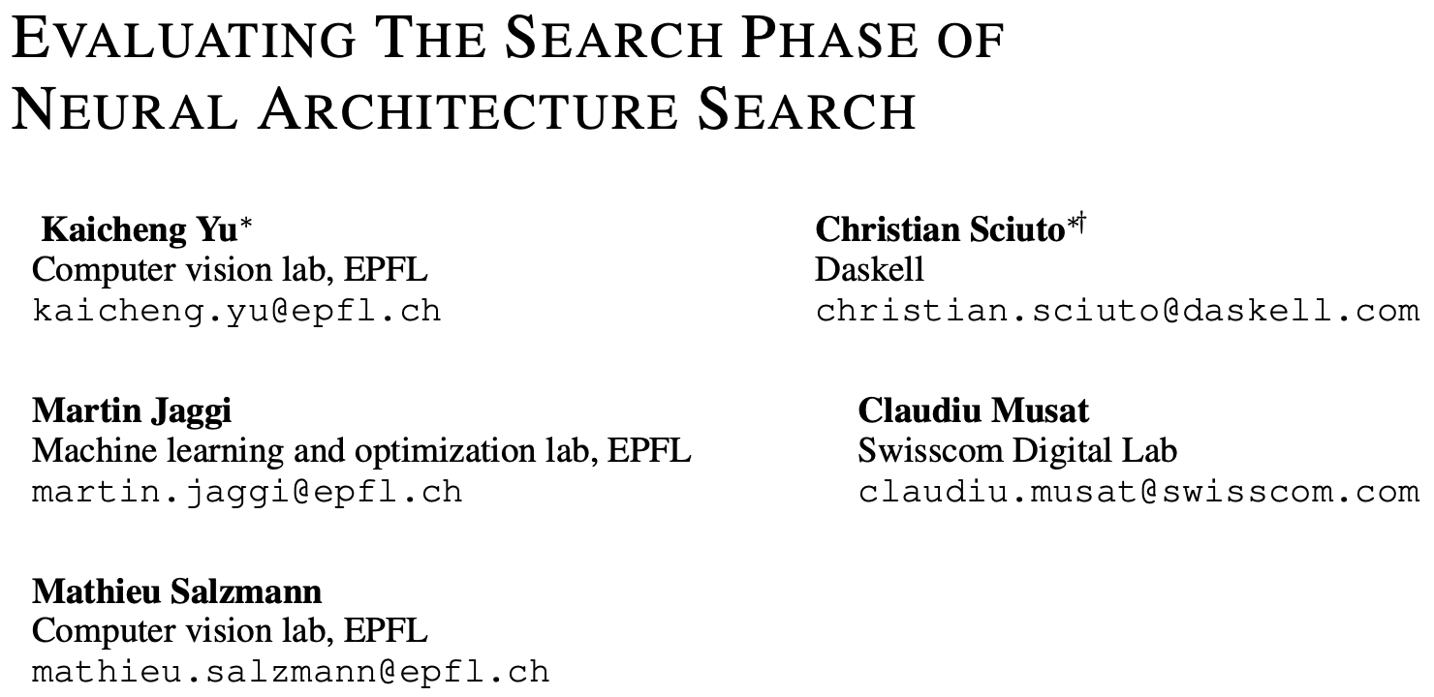

Slide 17
NAS Evaluation
NAS algorithms are typically compared based on their results in the evaluation phase.
The search phase of these algorithms often differ in several ways, such as their architecture sampling strategy and the search space they use.
The downstream task results are often reported for a single random seed, which leaves unanswered the question of robustness of the search strategies.

Slide 18
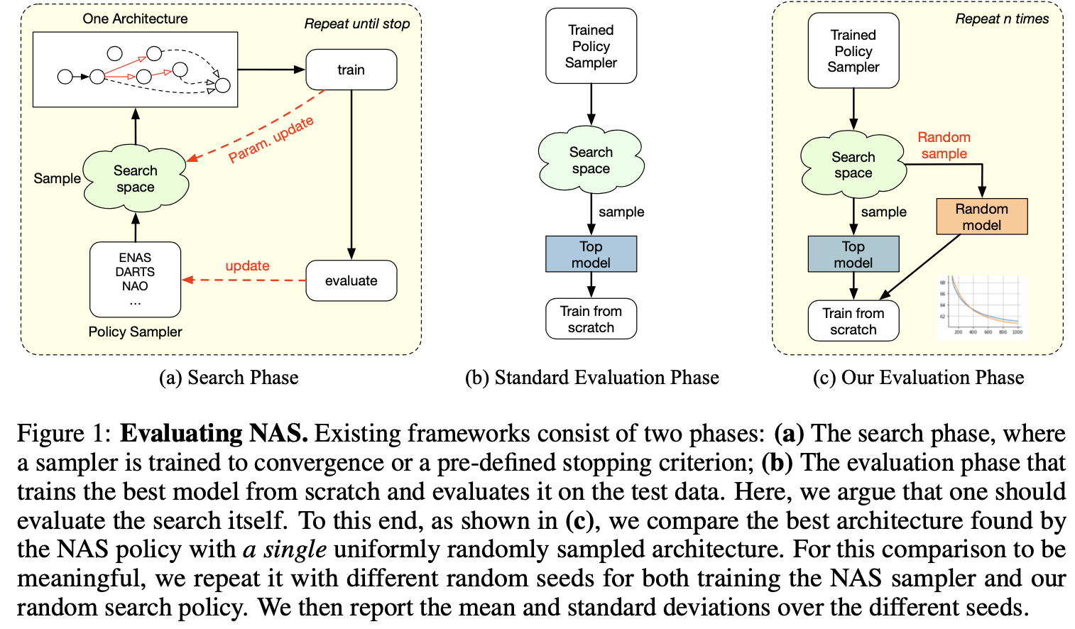
NAS Evaluation

Slide 19
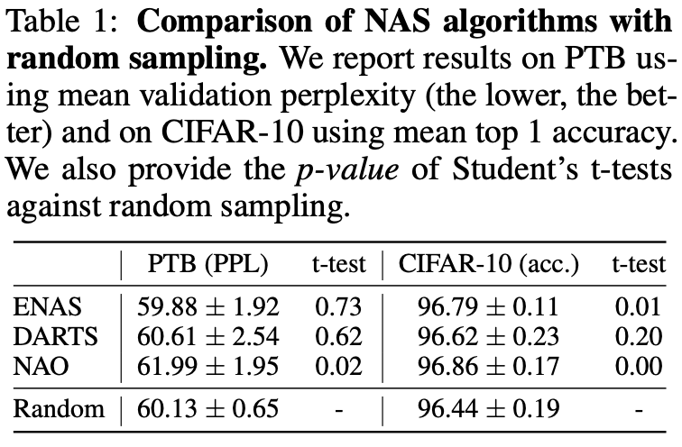
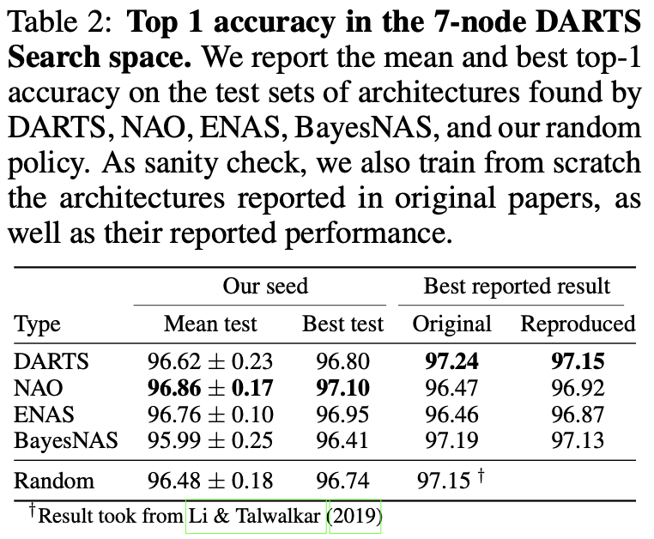
Experiment
RNN Result
CNN Result

Slide 20
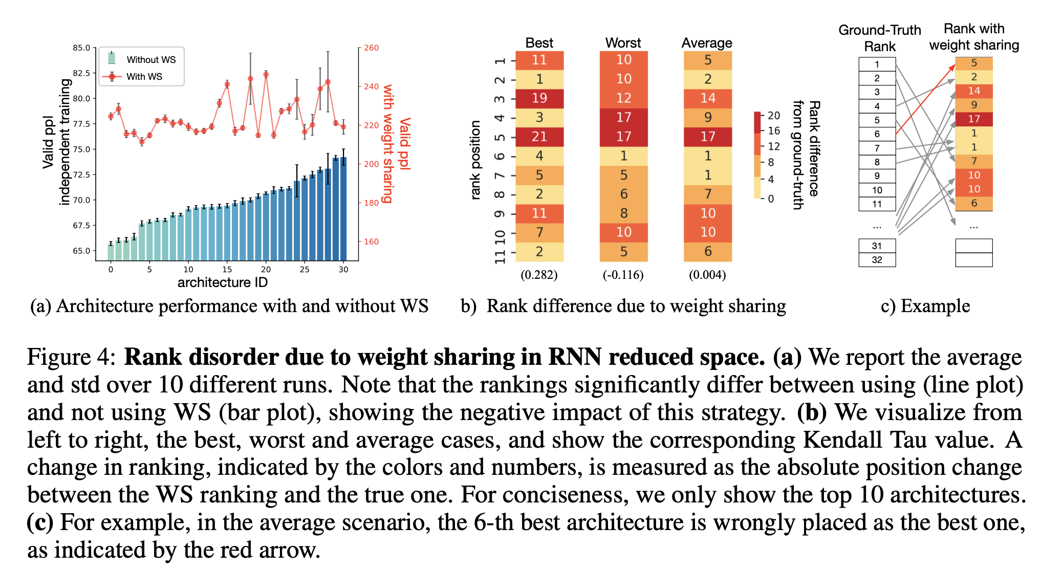
Impact of Weight Sharing

